Slide 1
Assignment #2
COMP 445
Cristian Rodriguez

Slide 2
Objective
In the previous assignment, we focused on the client side of HTTP.
The goal is to develop a programming library that implements the basic functionalities of the HTTP server.
We are going to manage a remote file system through HTTP request and responses.
Please, use only the Java Socket library.
Don’t use any other library that abstracts the socket programming for you.
Source: Assignment 2 handout

Slide 3
HTTP1.0 Full Response and Simple Response
Simple response:
Entity body.
Full response:
Status line
General Header
Response Header
Entity Header
CRLF = \r\n
Entity Body
Source: https://www.w3.org/Protocols/HTTP/1.0/spec.html

Slide 4
HTTP1.0 Full Response and Simple Response
A simple response should only be sent in response to an HTTP/0.9 Simple-Request or if the server only supports the more limited HTTP/0.9 protocol.
Simple response:
Entity body.
Full response:
Status line
General Header
Response Header
Entity Header
CRLF = \r\n
Entity Body
Source: https://www.w3.org/Protocols/HTTP/1.0/spec.html

Slide 5
HTTP1.0 Full Response and Simple Response
Note that the Simple-Response consist only of the entity body and is terminated by the server closing connection.
Simple response:
Entity body.
Full response:
Status line
General Header
Response Header
Entity Header
CRLF = \r\n
Entity Body
Source: https://www.w3.org/Protocols/HTTP/1.0/spec.html

Slide 6
HTTP1.0 Full Response and Simple Response
HTTP-version SP Status-Code SP Reason-Phrase CRLF
Simple response:
Entity body.
Full response:
Status line
General Header
Response Header
Entity Header
CRLF = \r\n
Entity Body
Source: https://www.w3.org/Protocols/HTTP/1.0/spec.html

Slide 7
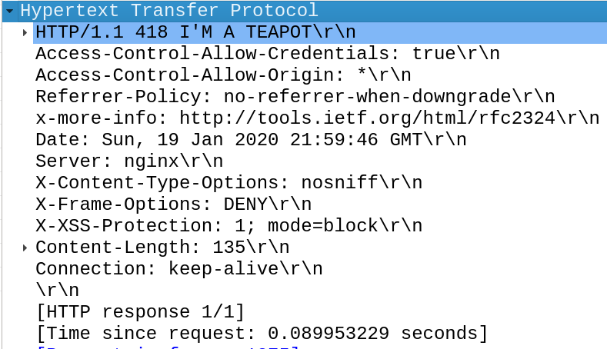
HTTP1.0 Full Response and Simple Response
HTTP-version SP Status-Code SP Reason-Phrase CRLF
Simple response:
Entity body.
Full response:
Status line
General Header
Response Header
Entity Header
CRLF = \r\n
Entity Body
Source: https://www.w3.org/Protocols/HTTP/1.0/spec.html

Slide 8
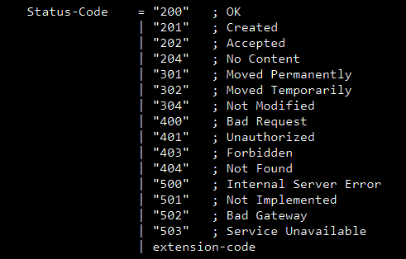
HTTP1.0 Full Response and Simple Response
HTTP-version SP Status-Code SP Reason-Phrase CRLF
Simple response:
Entity body.
Full response:
Status line
General Header
Response Header
Entity Header
CRLF = \r\n
Entity Body
Source: https://www.w3.org/Protocols/HTTP/1.0/spec.html

Slide 9
HTTP1.0 Full Response and Simple Response
HTTP-version SP Status-Code SP Reason-Phrase CRLF
Simple response:
Entity body.
Full response:
Status line
General Header
Response Header
Entity Header
CRLF = \r\n
Entity Body
Text, excluding /r /n
Source: https://www.w3.org/Protocols/HTTP/1.0/spec.html

Slide 10
HTTP1.0 Full Response and Simple Response
Date
Pragma
Simple response:
Entity body.
Full response:
Status line
General Header
Response Header
Entity Header
CRLF = \r\n
Entity Body
Source: https://www.w3.org/Protocols/HTTP/1.0/spec.html

Slide 11
HTTP1.0 Full Response and Simple Response
Date
Simple response:
Entity body.
Full response:
Status line
General Header
Response Header
Entity Header
CRLF = \r\n
Entity Body
Source: https://www.w3.org/Protocols/HTTP/1.0/spec.html

Slide 12
HTTP1.0 Full Response and Simple Response
Pragma
Simple response:
Entity body.
Full response:
Status line
General Header
Response Header
Entity Header
CRLF = \r\n
Entity Body
“no-cache”
This is passed through by a proxy or gateway application
Source: https://www.w3.org/Protocols/HTTP/1.0/spec.html

Slide 13
HTTP1.0 Full Response and Simple Response
Location
Server
WWW-Authenticate
Simple response:
Entity body.
Full response:
Status line
General Header
Response Header
Entity Header
CRLF = \r\n
Entity Body
Source: https://www.w3.org/Protocols/HTTP/1.0/spec.html

Slide 14
HTTP1.0 Full Response and Simple Response
Location
Simple response:
Entity body.
Full response:
Status line
General Header
Response Header
Entity Header
CRLF = \r\n
Entity Body
Defines the location of the resource for 3xx responses.
Source: https://www.w3.org/Protocols/HTTP/1.0/spec.html

Slide 15
HTTP1.0 Full Response and Simple Response
Server
Simple response:
Entity body.
Full response:
Status line
General Header
Response Header
Entity Header
CRLF = \r\n
Entity Body
Source: https://www.w3.org/Protocols/HTTP/1.0/spec.html

Slide 16
HTTP1.0 Full Response and Simple Response
WWW-Authenticate
Simple response:
Entity body.
Full response:
Status line
General Header
Response Header
Entity Header
CRLF = \r\n
Entity Body
Included in 401 responses. It includes a challenge that indicates the authentication schema.
Source: https://www.w3.org/Protocols/HTTP/1.0/spec.html

Slide 17
HTTP1.0 Full Response and Simple Response
Allow
Content-Encoding
Content-Length
Content-Type
Expires
Last-Modified
Extension-header
Simple response:
Entity body.
Full response:
Status line
General Header
Response Header
Entity Header
CRLF = \r\n
Entity Body
Source: https://www.w3.org/Protocols/HTTP/1.0/spec.html

Slide 18
HTTP1.0 Full Response and Simple Response
Allow
Simple response:
Entity body.
Full response:
Status line
General Header
Response Header
Entity Header
CRLF = \r\n
Entity Body
Informs the recipient of valid methods associated with the resource.
Source: https://www.w3.org/Protocols/HTTP/1.0/spec.html

Slide 19
HTTP1.0 Full Response and Simple Response
Content-Encoding
Simple response:
Entity body.
Full response:
Status line
General Header
Response Header
Entity Header
CRLF = \r\n
Entity Body
Indicates the content coding applied to the resource to allow a document to be compressed or encrypted.
Source: https://www.w3.org/Protocols/HTTP/1.0/spec.html

Slide 20
HTTP1.0 Full Response and Simple Response
Content-Length
Simple response:
Entity body.
Full response:
Status line
General Header
Response Header
Entity Header
CRLF = \r\n
Entity Body
The size of the Entity body in decimal number of octets. A value greater than or equal to zero is a valid value.
Source: https://www.w3.org/Protocols/HTTP/1.0/spec.html

Slide 21
HTTP1.0 Full Response and Simple Response
Content-Type
Simple response:
Entity body.
Full response:
Status line
General Header
Response Header
Entity Header
CRLF = \r\n
Entity Body
Indicates the media type of the entity body. For example: text/html
Source: https://www.w3.org/Protocols/HTTP/1.0/spec.html

Slide 22
HTTP1.0 Full Response and Simple Response
Expires
Simple response:
Entity body.
Full response:
Status line
General Header
Response Header
Entity Header
CRLF = \r\n
Entity Body
Gives the date/time after which the entity should be considered stale.
Source: https://www.w3.org/Protocols/HTTP/1.0/spec.html

Slide 23
HTTP1.0 Full Response and Simple Response
Last-Modified
Simple response:
Entity body.
Full response:
Status line
General Header
Response Header
Entity Header
CRLF = \r\n
Entity Body
Gives the date/time after which the sender knows the resource was last modified.
Source: https://www.w3.org/Protocols/HTTP/1.0/spec.html

Slide 24
HTTP1.0 Full Response and Simple Response
Simple response:
Entity body.
Full response:
Status line
General Header
Response Header
Entity Header
CRLF = \r\n
Entity Body
All 1xx, 204 (no content) and 304 (not modified) responses must not include a body.
Source: https://www.w3.org/Protocols/HTTP/1.0/spec.html

Slide 25
File server application
GET /
Returns a list of the current files in the data directory.
You can return different type format such as JSON, XML, plain text, HTML, according to the Accept key of the request.
This is not mandatory; you can ignore this header a return the same type format.
GET /foo
Returns the content of the file named foo in the data directory.
IF the content does not exist, you should return 404 code.
POST /bar
Should create or overwrite the file named bar in the data directory with the content of the body of the request.
You can implement more options for the POST such as overwrite=true|false.
This is optional.
Source: Assignment 2 handout

Slide 26
Secure access
Your implementation may have a severe access vulnerability.
The user can access files outside the working directory.
You should program a mechanism to prevent clients to read/write any file outside the file server working directory.
Source: Assignment 2 handout

Slide 27
Error Handling
If the requested file doesn’t exist, the file server should send an appropriate message.
If the server is unable to process the request due to security reasons, an appropriate handling must be performed.
Source: Assignment 2 handout

Slide 28
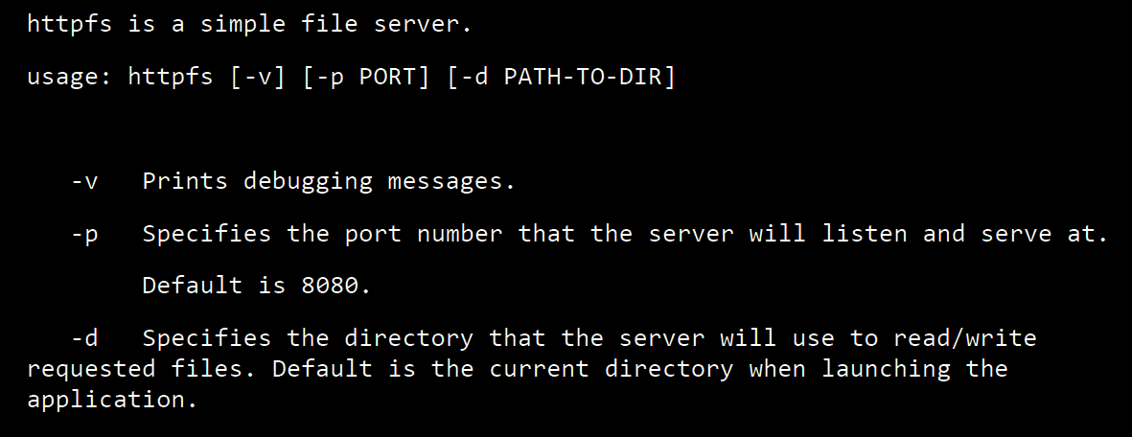
Usage
Source: Assignment 2 handout

Slide 29
Bonus marks
Multi-request support
Two clients are writing to the same file.
One client is reading, while another is writing to the same file.
Two clients are reading the same file.
Content-Type & Content-Disposition Support
Set appropriate values to the headers Content-type and Content-Disposition.
Source: Assignment 2 handout

Slide 30
Grading
Parsing: 3
Design and Reusability: 1
Connectivity: 1
GET: 1
POST: 1
Directory Manipulation/Management: 1
File Manipulation/Management: 1
Security: 0.5
Error Handling: 0.5
Bonus
Concurrent Request: 1
Content-type and Content-Disposition: 1
Source: Assignment 2 handout

